Slide 1
Machine Learning Meets Phylodynamics
A modern approach for historical host shifts

Slide 2
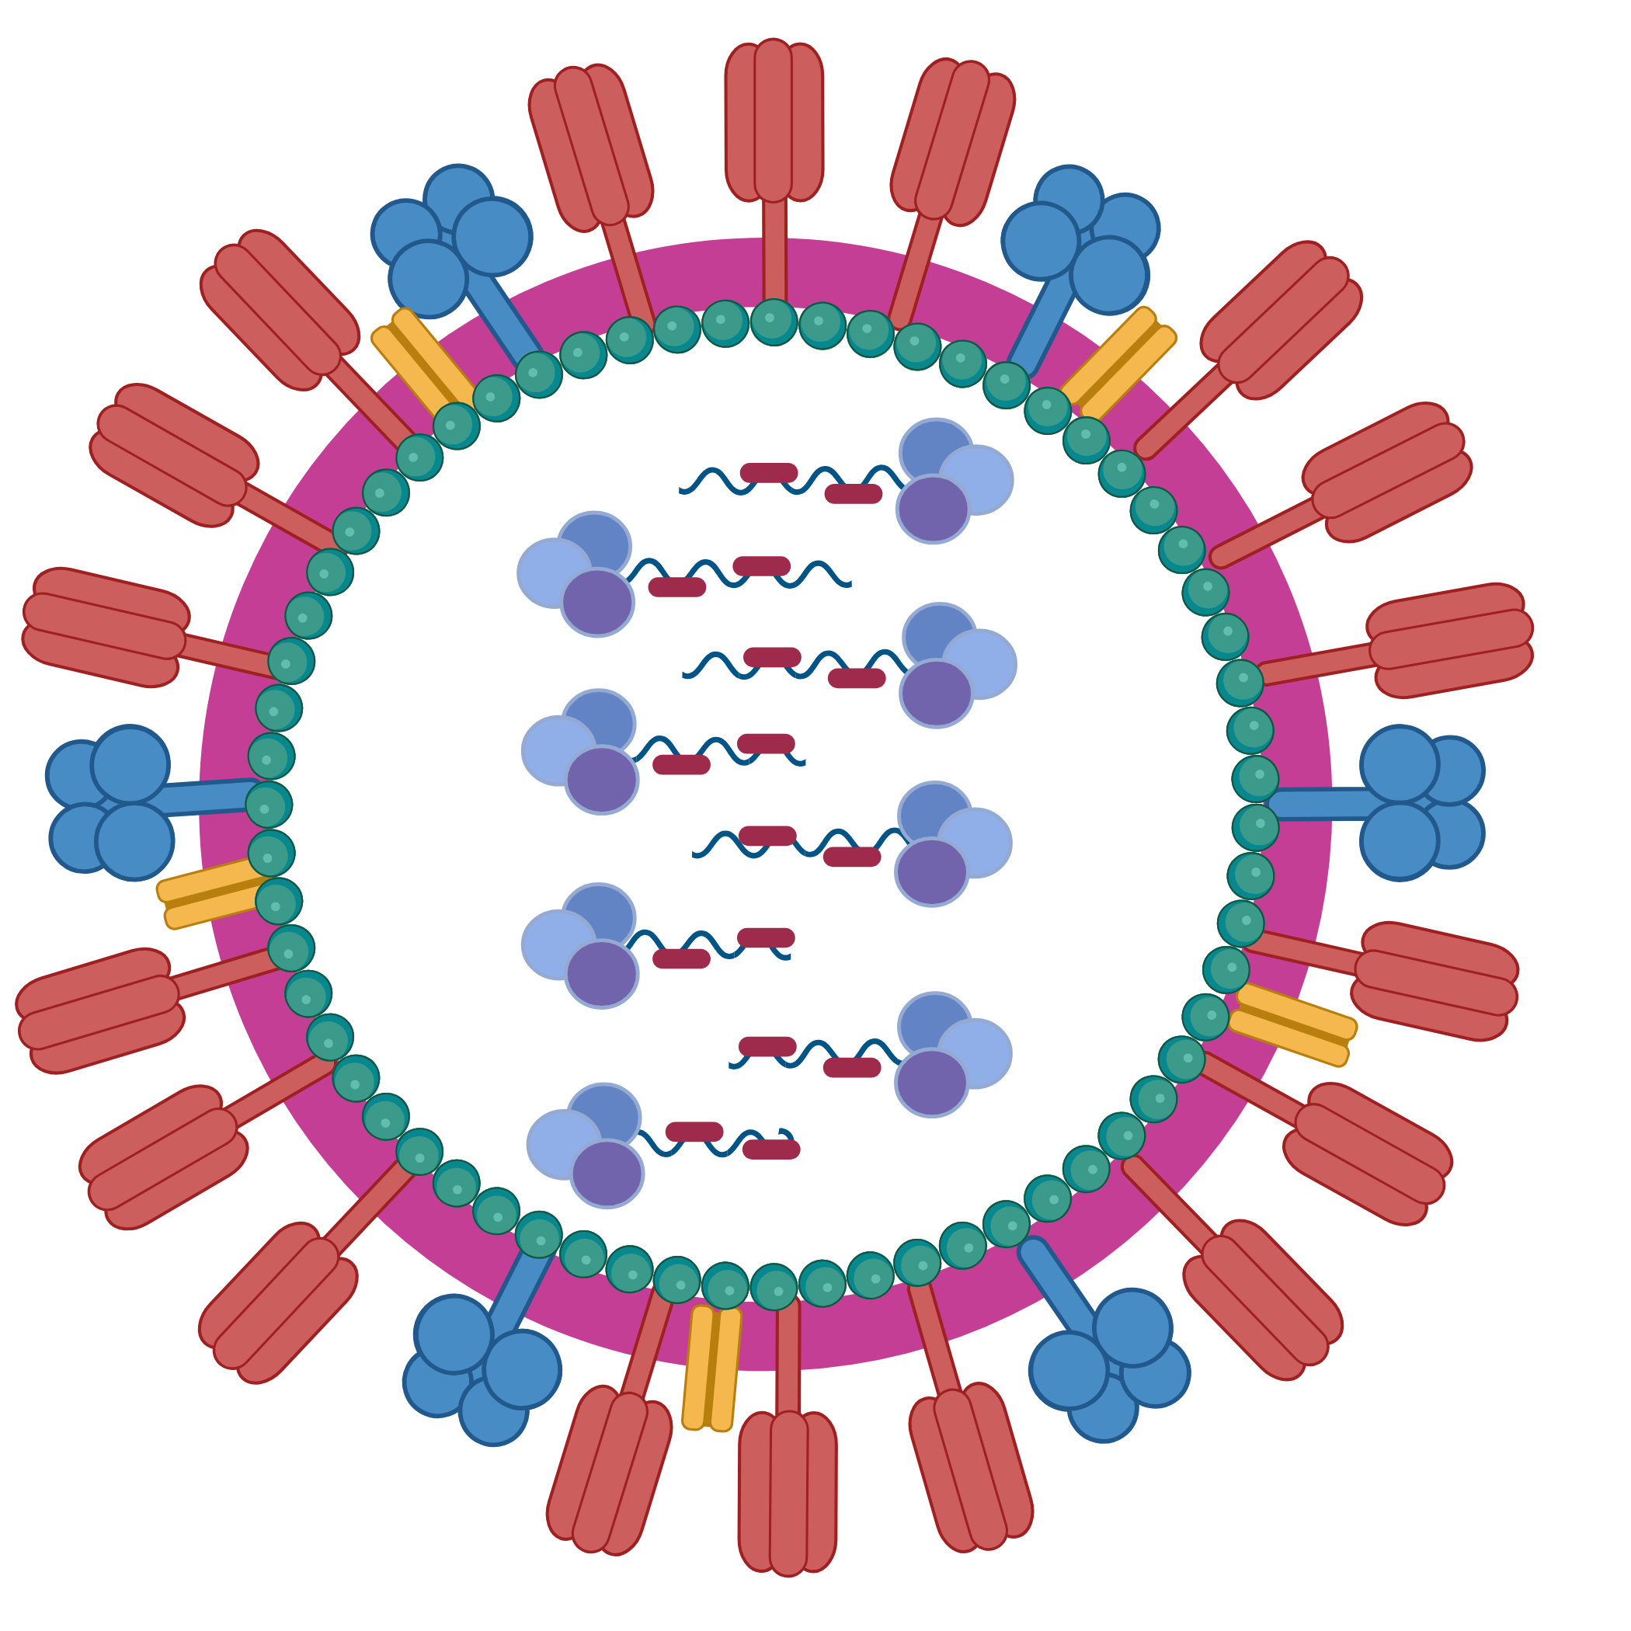
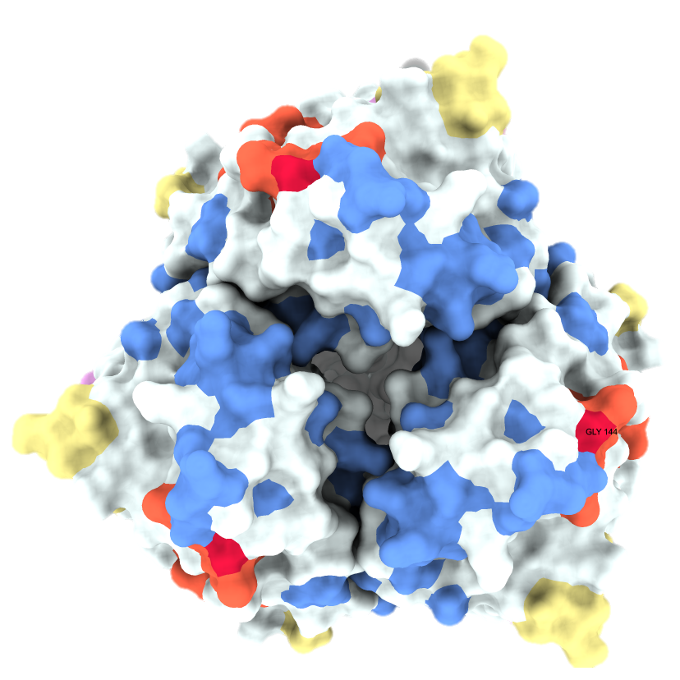
Acc | CTDC hydrophobicity PRAM900101 |  |  | CTDC charge |  |  | Protein
 | G1 | G2 | G3 | G1 | G2 | G3
AAB50960.1 | 0.2963 | 0.4213 | 0.2824 | 0.1019 | 0.8079 | 0.0903 | 04HA
AAB52906.1 | 0.2966 | 0.4190 | 0.2844 | 0.1040 | 0.8043 | 0.0917 | 04HA
ARX97458.1 | 0.3392 | 0.3445 | 0.3163 | 0.1113 | 0.7827 | 0.1060 | 04HA
ASB30836.1 | 0.3292 | 0.3522 | 0.3186 | 0.1080 | 0.7858 | 0.1062 | 04HA
ASB31513.1 | 0.3080 | 0.3788 | 0.3133 | 0.0991 | 0.7965 | 0.1044 | 04HA
ASB32557.1 | 0.3115 | 0.3788 | 0.3097 | 0.0973 | 0.7947 | 0.1080 | 04HA
ASB32605.1 | 0.3269 | 0.3534 | 0.3198 | 0.1042 | 0.7968 | 0.0989 | 04HA
ASB33546.1 | 0.3186 | 0.3717 | 0.3097 | 0.0956 | 0.7912 | 0.1133 | 04HA
ASB34007.1 | 0.3180 | 0.3816 | 0.3004 | 0.1025 | 0.7880 | 0.1095 | 04HA
IAV
Gene
Protein
Protein Physio-chemical Properties

Slide 3
Notes:
So which data did we use? We pulled all instances of flu genomes from NCBI when the host of origin was known and there were sequences for all 8 IAV genomic segments. Next, as the focus is on historical host shifts, we wanted only to keep samples that have naturally circulated in hosts from at least a year – no spillovers or recent jumps. This is just because the type of protein features tend to evolve slowly and take some time to adapt to a new host. Then, to train the models, we identified the IAV subtypes that appeared most frequently – subtypes which had more than 25 samples. The exception to this was two bat-specific subtypes, which had only 5 samples between them, but we needed some bat sequences to be included so the model had something to train on & recognise.

Slide 4
Nucleotide or Protein sequences
Machine Learning
Physico-chemical properties of proteins
Phylogenetics
Inherently related to virus meta-data (host, subtype, etc.)
Agnostic of virus meta-data
Easy to add new observations
Analyses are fairly intuitive
Analyses can be rather abstract to interpret
Time-sensitive
Relates samples to each other
Can be experimentally-validated
Generalisable to other samples
Not generalisable to other samples
Struggles with highly-divergent samples
Able to incorporate highly-divergent samples
Sequence based

Slide 5
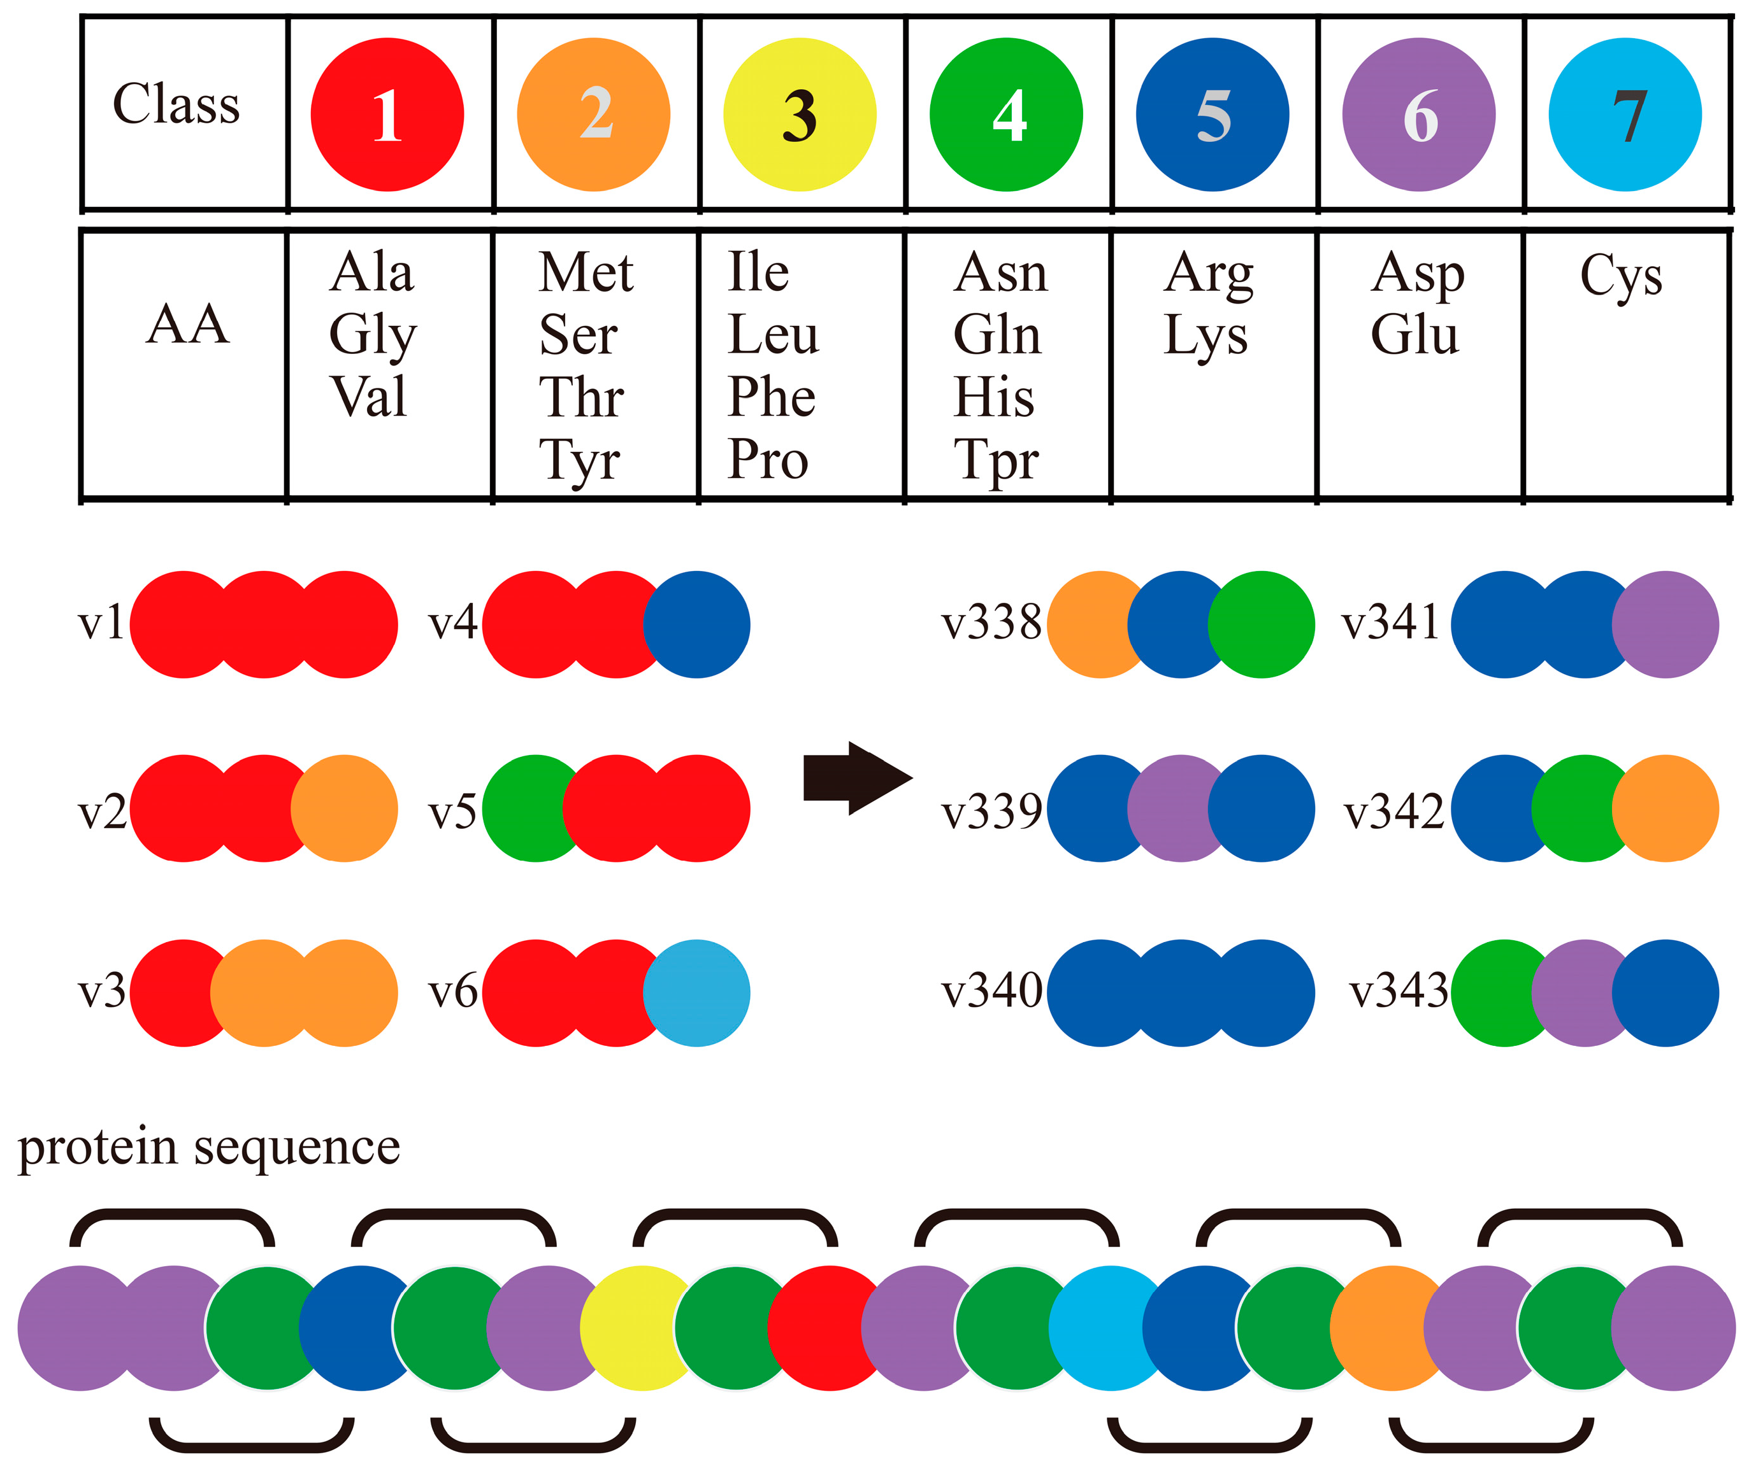
Machine Learning Models
Sequences are labelled according to the host of origin
Random Forest models are trained on protein properties
Compositional features
Physio-chemical features
1)
2)
3)
Notes:
So what kind of models are we talking about when referencing “protein features”? So far, we’ve stuck with a handful of features that describe the composition of protein sequences: how many times do certain amino acids show up within the protein, what sort of amino acids are present in the protein? Like the example illustrated here, where the amino acid alphabet is reduced to just 7 groups based on similar charges, weights, that kind of thing. Or alternatively, just raw metrics regarding the protein as a whole: its hydrophobicity, its solubility, charge etc.
These are what we used in creating the many, many random forest models that are the basis of this half of the project.

Slide 6
Random Forests
100 labelled sequences
RF₁
30 seqs
RF₂
30 seqs
RF₃
30 seqs
root
root
root
Avian
Mammal
Avian
Mammal
Avian
Mammal
Validate using the remaining 10 seqs
root
Aggregate
Avian
Mammal
Notes:
Onto a brief summary of random forests, for those who may be unfamiliar with them. It basically boils down to sorting algorithms – labelled training data are fed into the model; that is, the features we just discussed which all receive some kind of distinguishing label – here whether the virus that the protein comes from was isolated from an avian or a mammalian host. The training data are divided up into groups and each group is used to train one tree. Here as an example, we take our 100 sequences and split them into 3 groups of 30, each one of those groups is used to train a separate decision tree which are then all aggregated to form a final predictive model tree. Much like bootstrapping a maximum likelihood phylogenetic tree, its trees all the way down!
The benefit of creating models in this way is that any samples that were not part of the original groupings (our 10 leftover sequences) can then be presented to the model as novel data. Therefore, validating how well our model actually performs because we know which label those sequences had, whether they came from avian or mammalian hosts.

Slide 7
Accession | Subtype | Label | DPC AA | DPC AD | DPC AE
AFM09352.1 | H5N2 | Avian | 0.00664 | 0.00398 | 0.00133
JN543647.1 | H9N2 | Avian | 0.00535 | 0.00402 | 0.00134
JN543651.1 | H9N2 | Avian | 0.00536 | 0.00402 | 0.00134
JN543662.1 | H9N2 | Avian | 0.00670 | 0.00402 | 0.00134
AIE48553.1 | H1N1 | Mammalian | 0.00528 | 0.00264 | 0.00264
AIE48735.1 | H1N1 | Mammalian | 0.00528 | 0.00264 | 0.00264
AIE49234.1 | H1N1 | Mammalian | 0.00661 | 0.00264 | 0.00264
AEK86179.1 | H1N2 | Mammalian | 0.00661 | 0.00132 | 0.00264
Model₁: Label ~ AA+AD+AE…
using the features from non-H1N1 proteins only
Notes:
We therefore start with ~35,000 sequences, but many of these were similar enough to provide little novel information to the model so our first step was to cut down on the number of sequences we’d use. A clustering algorithm (within the MMSeq2 program) ran over these samples and retained only those which had 95% or lower sequence identity in order to capture the widest range of diverse proteins. This narrowed us down to just under 6700 proteins in total; some of which were from the same virus so we ended up with 4551 unique virus genomes.
Then compositional and chemical features of proteins calculated with iFeaturesOmega were used to train random forest models. As I mentioned, an important part of creating these RF models is holding out a subset of the data to be used as part of the validation process; therefore each of the 25 flu subtypes we identified was removed iteratively from the training data.
The first model used the 2mers as the predictive feature for the HA protein, using all of the dataset except for the proteins coming from H1N1 viruses. So the first model sees all of the non-H1N1 HA proteins and “learns” to classify sequences as avian or mammalian based on their protein features. Then, the H1N1 data that we hid from the model is presented as entirely novel and used to make a prediction; the model has never seen any of these H1N1 sequences before so can it attribute the correct label to them?

Slide 8
Feed H1N1 test data into Stack₁ model to assess model competency
Repeat for each of the 25 selected subtypes
Notes:
So all of that is just the first model! We then expand this to each of the protein features and each of the 8 major IAV proteins. Resulting in 48 different models which are then stacked – compiled in a way such that any features of any protein could be fed into the model and we get an output prediction of whether that protein is from an avian or mammalian virus. Then, we go back to the beginning of the modelling process to do the same with H1N2: proteins of H1N2 viruses are “held-out” and we make another 48 models of each feature set and each protein which are combined into Stack 2. Stack 2 is then validated using the H1N2 data that we put back in and you get the picture… A collection of models that look at the input of some protein features and give an estimate of whether the protein comes from avian or mammalian viruses.

Slide 9
Machine Learning Models
Segment_{[1-8]} • Feature_{[1-6]} • Subtype_{[1-25]} • Class_{[1-2]}
1200 two-class models (Avian/Mammalian)
1200 multi-class models (Avian/Bat/Dog/Horse/Human/Pig)
Compile the feature models together to combine their predictions
200 two-class stacks
200 multi-class stacks
Notes:
The final part of model construction which I haven’t touched on yet is the class of labels. So far, everything example I’ve said has been based on a simple, two-class classification – is the origin host avian or mammalian? However, just like phylogenetic trees, the decision trees made as part of the random forest modelling can branch internally and add extra classifications. If a sequence is from a mammalian host, is that host a bat, a dog? Hence, for each model, we actually made two versions – a two-class and multi-class versions. They function the exact same, the multi-class one just has additional labels: bat, dog, horse, human and pig rather than just mammalian.

Slide 10
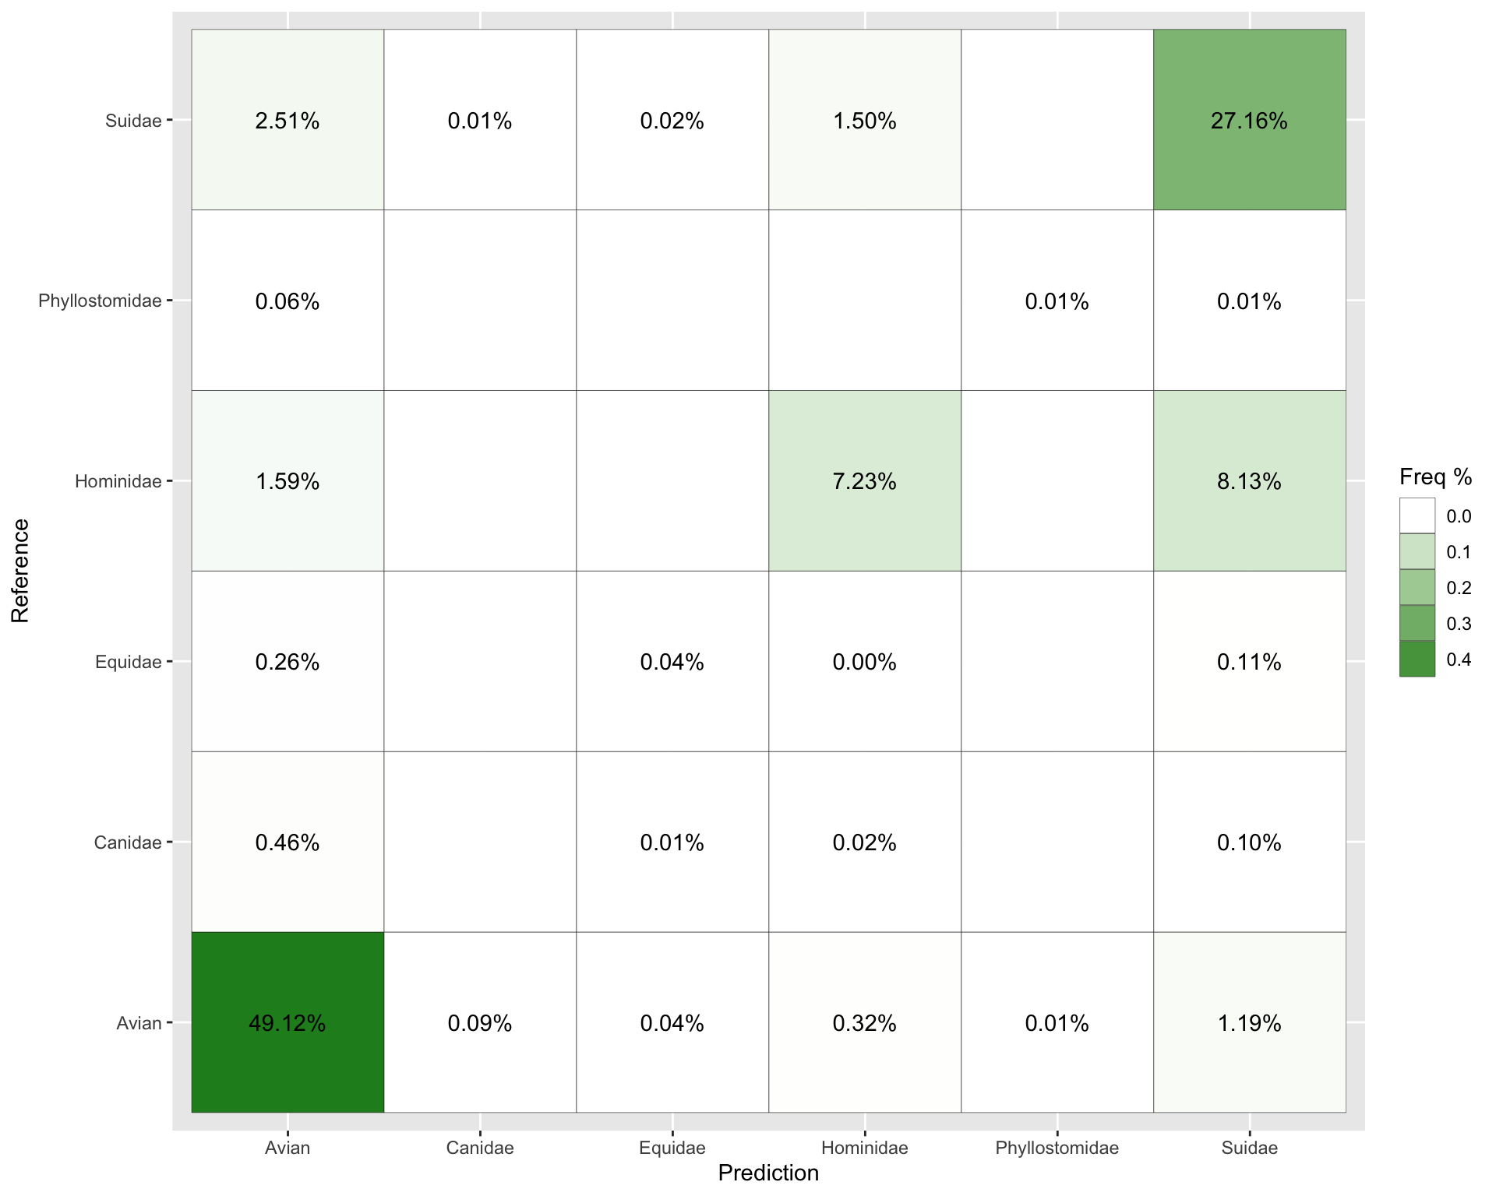
Frequency of Mis-labelled Predictions
Frequencies <0.01% not shown
2.51% of swine-origin samples were incorrectly predicted as avian-origin
Human-origin sequences were more likely to be classed as swine-origin (8.13%) than from humans (7.23%)

Slide 11
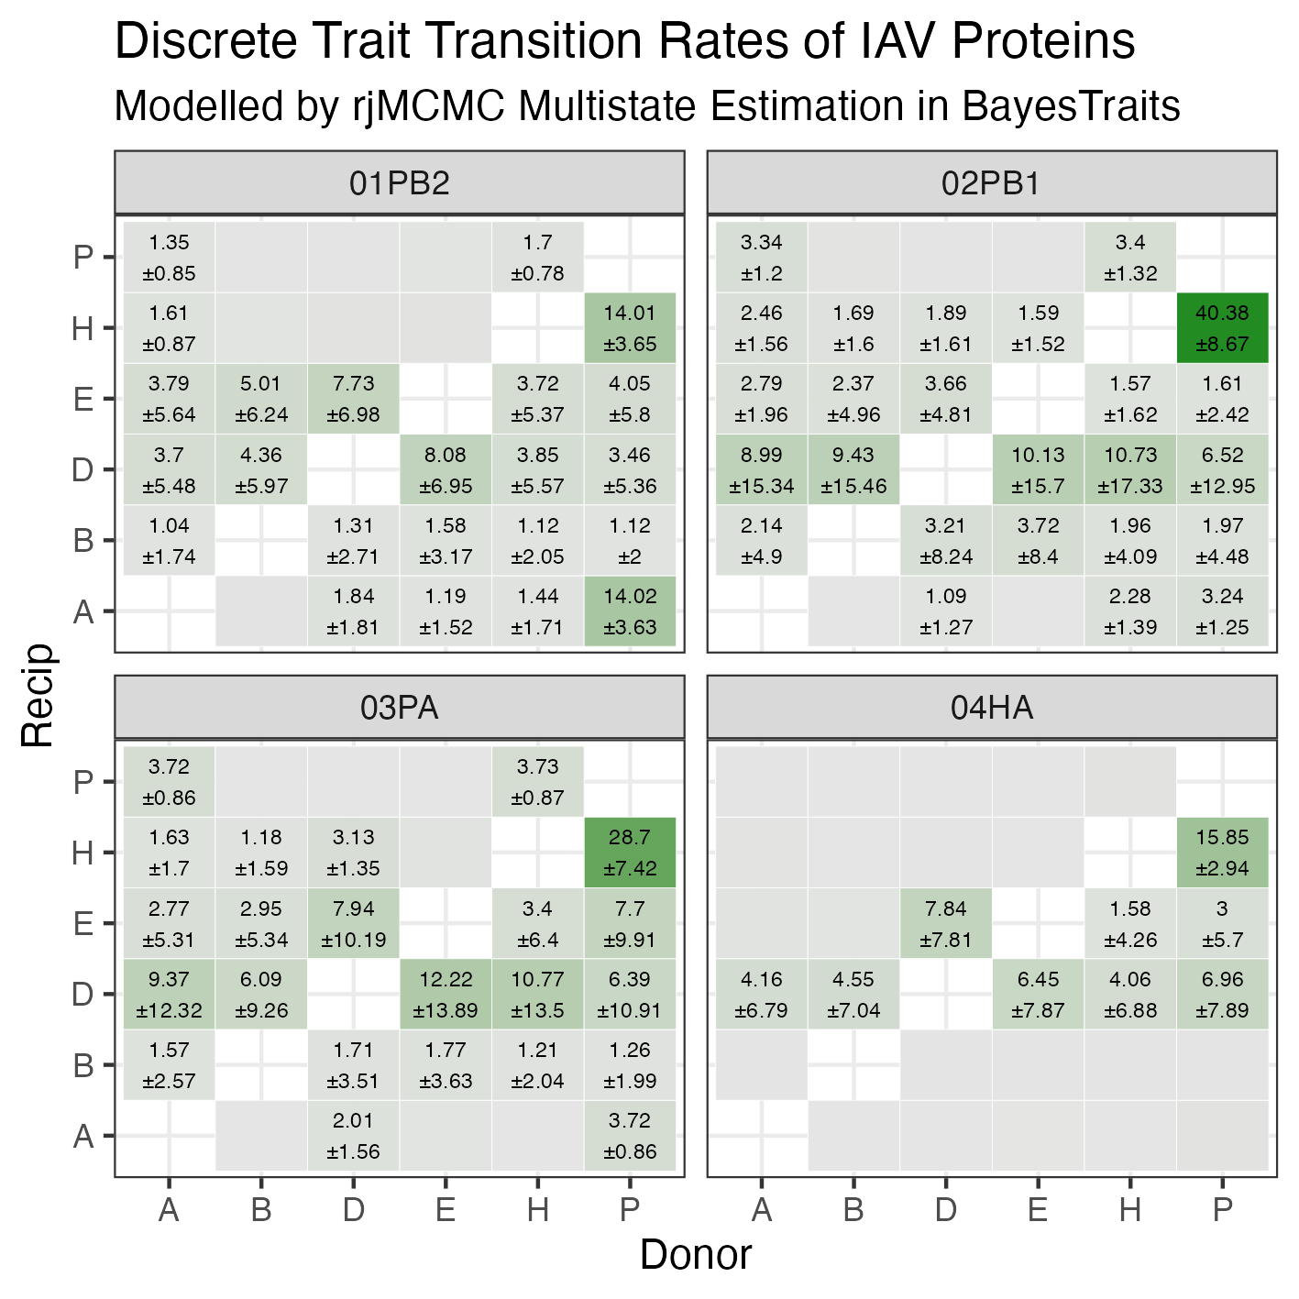
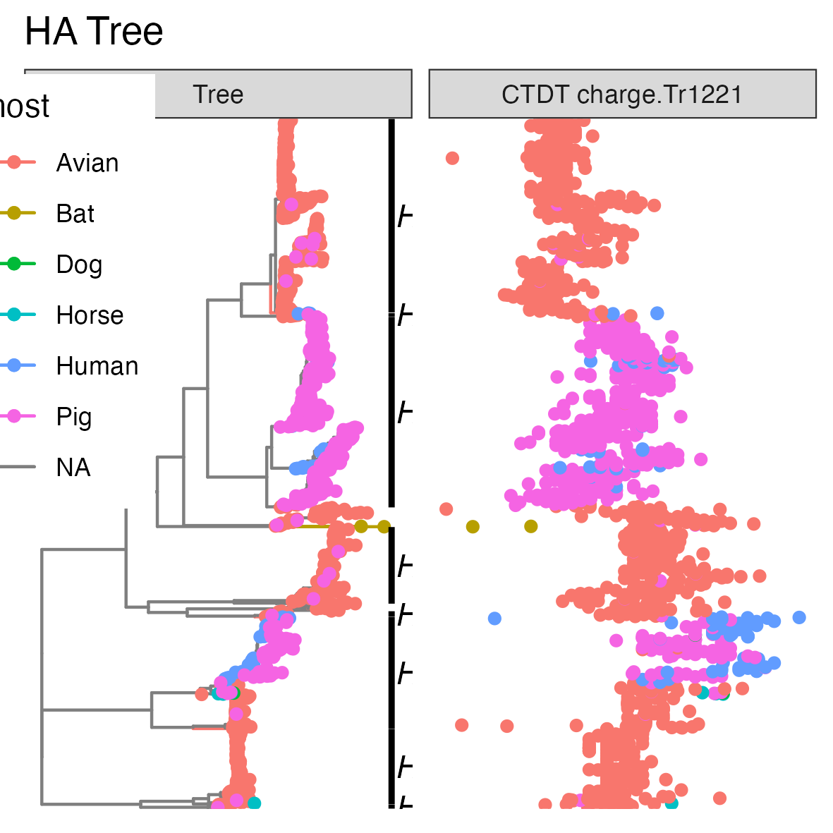
Phylogenetics
How neatly do protein physio-chemical properties map onto trees?
8 trees, one for each genomic segment
Do the patterns match predictions from the ML models?
Notes:
With the models (almost) done, I’m moving onto the phylogenetics side of the project

Slide 12
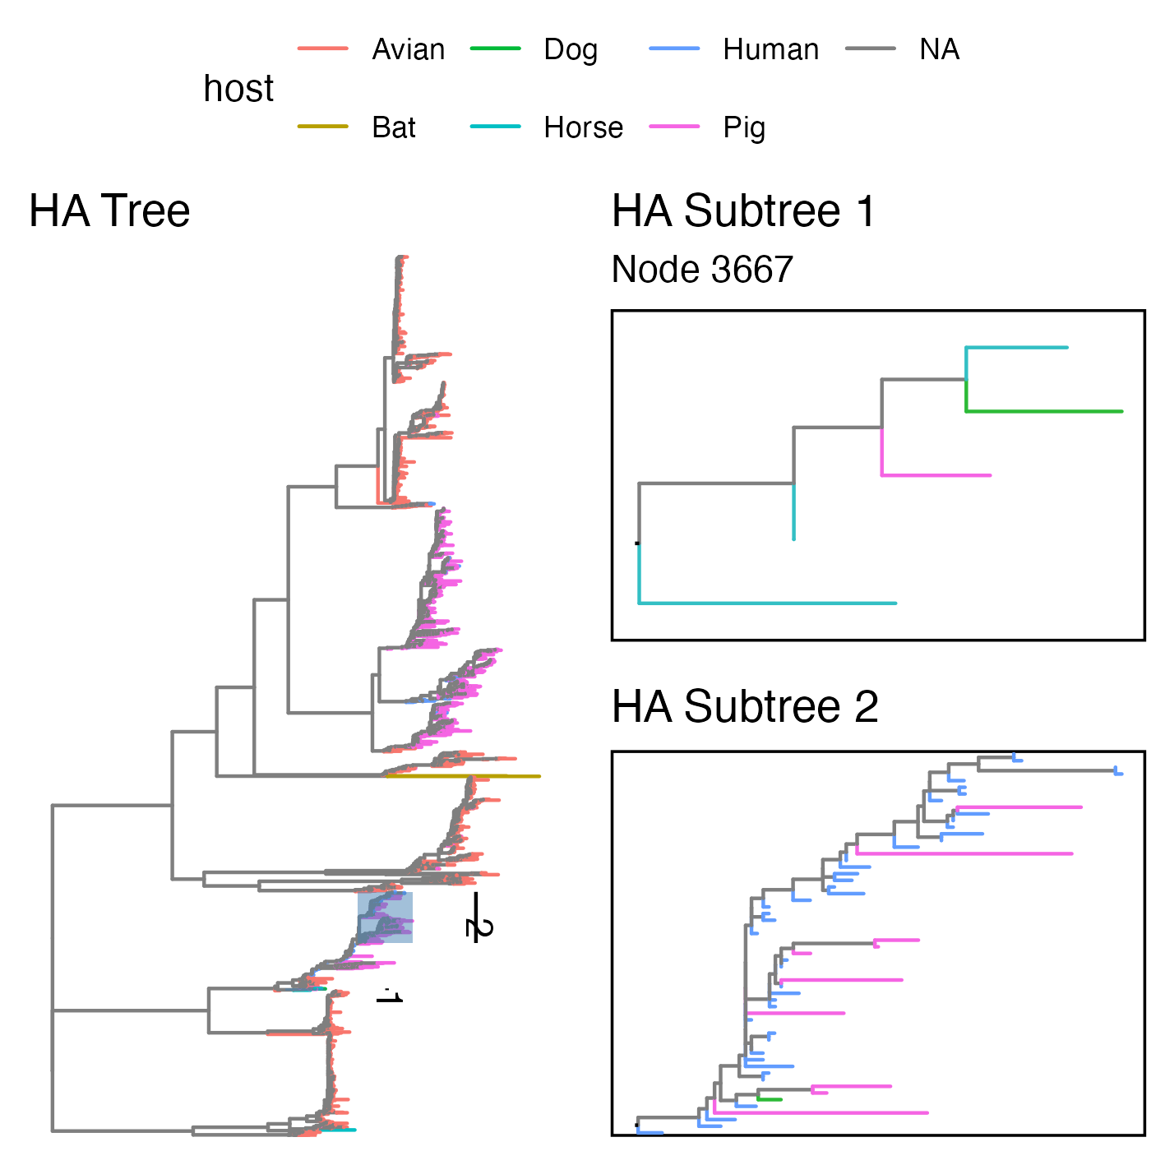
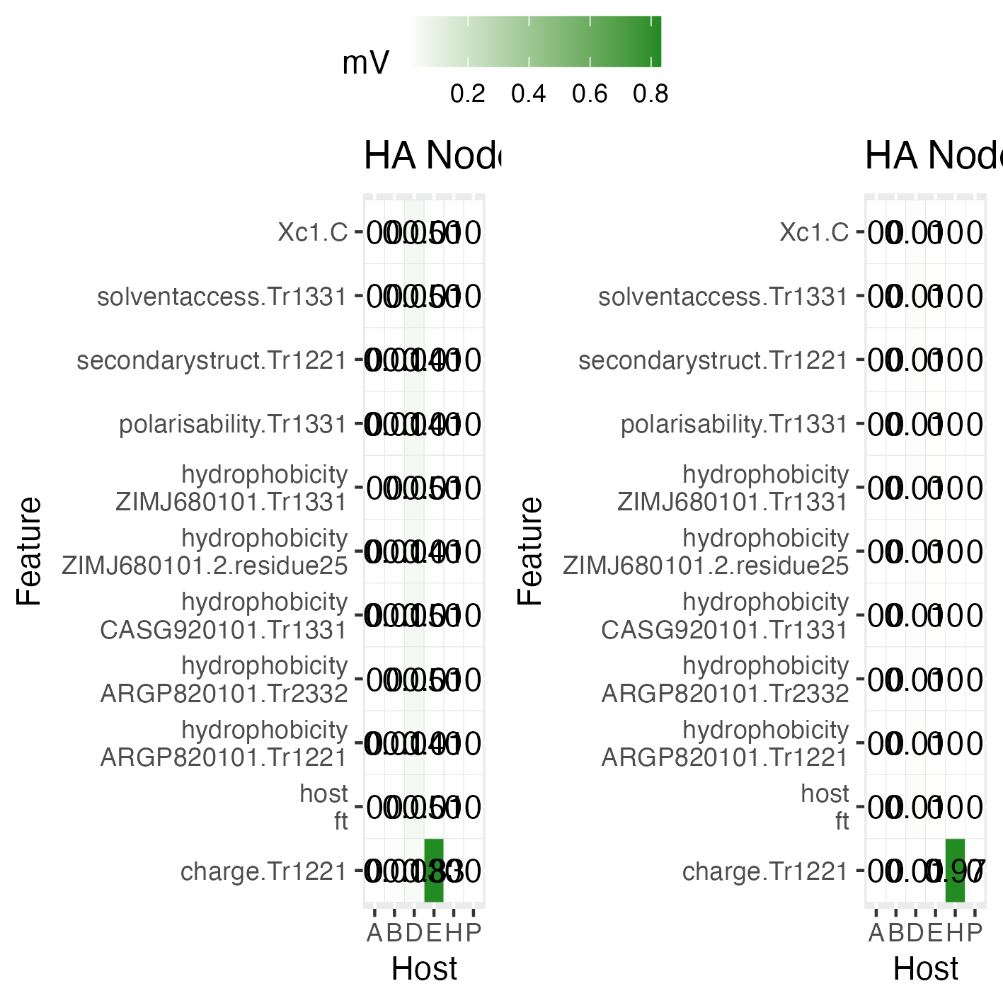

Slide 13
Future Directions
Protein sub-regions
Haemagglutinin stalk vs head
Further host splits
waterfowl vs other birds

Slide 14



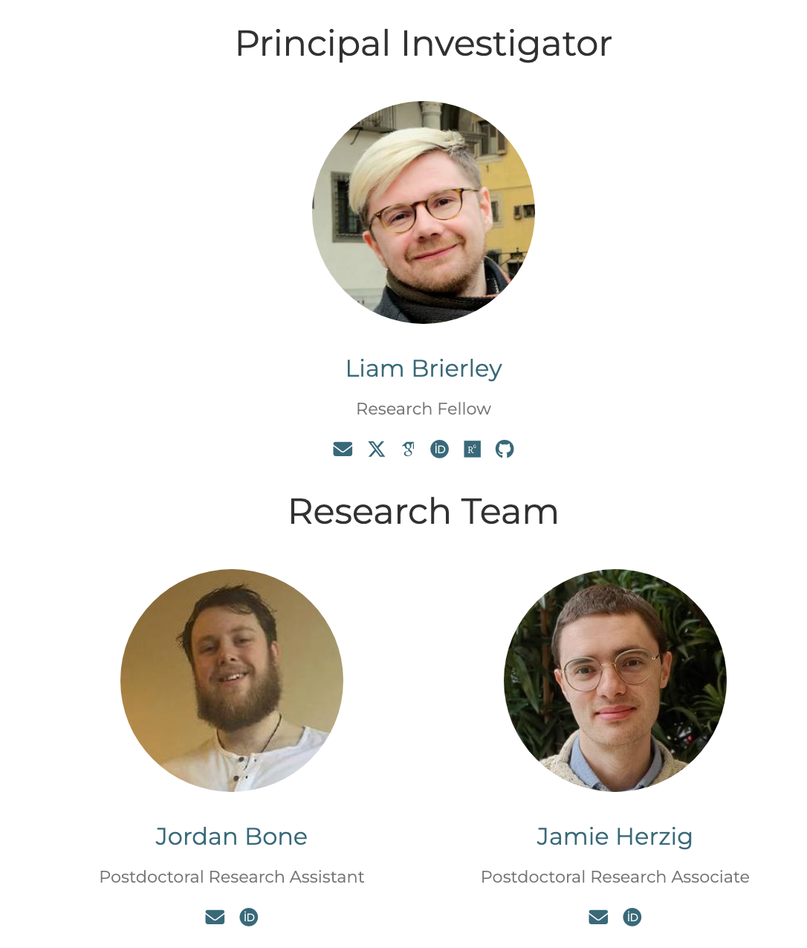



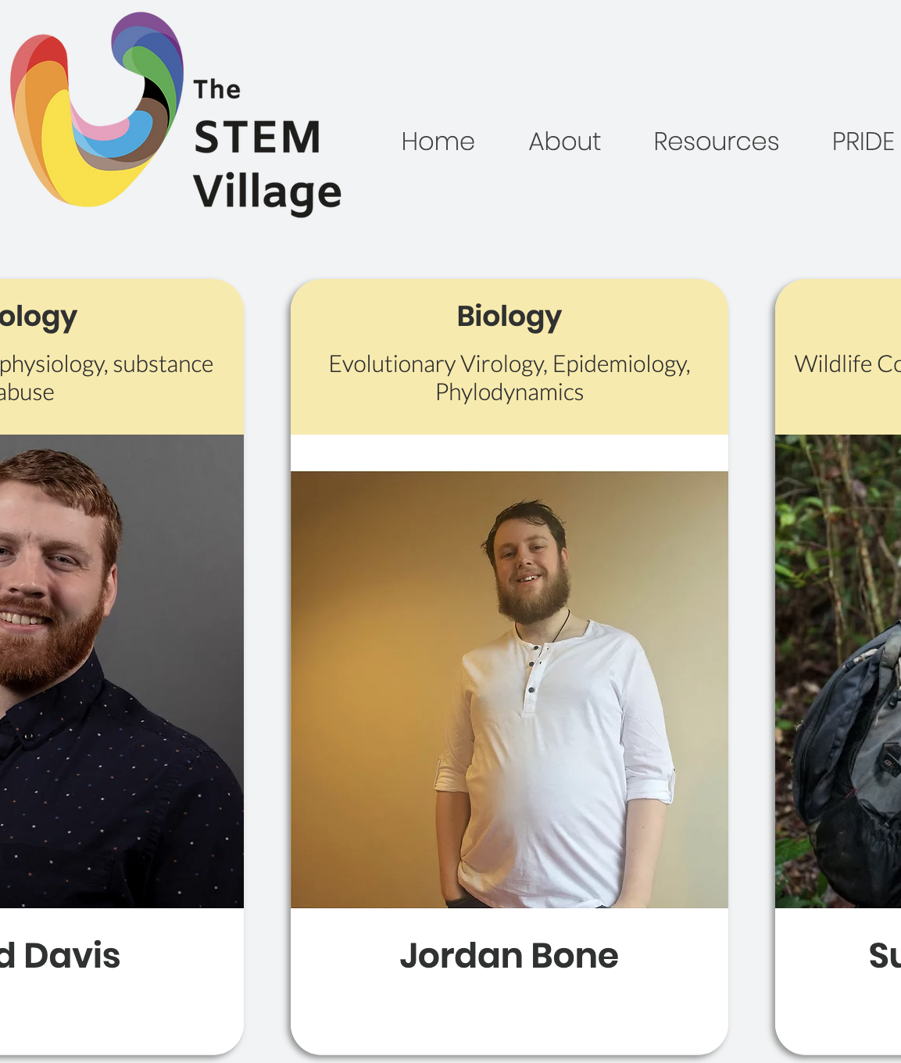

VIBE (Viral Informatics, Biostatistics, and Evolution) Research Lab
LinkedIn

